Slide 1
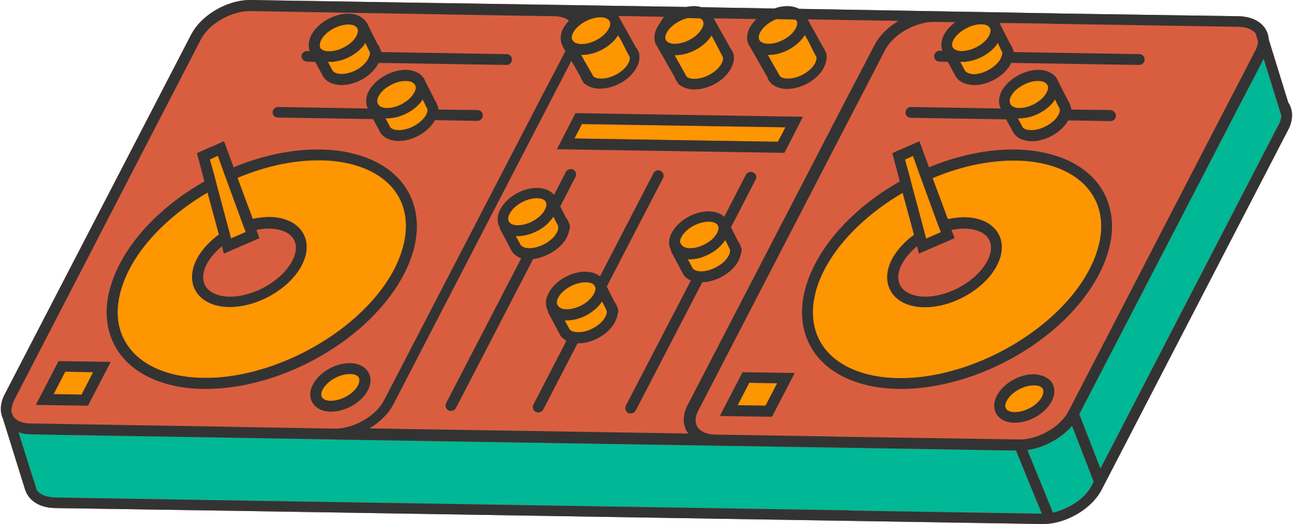


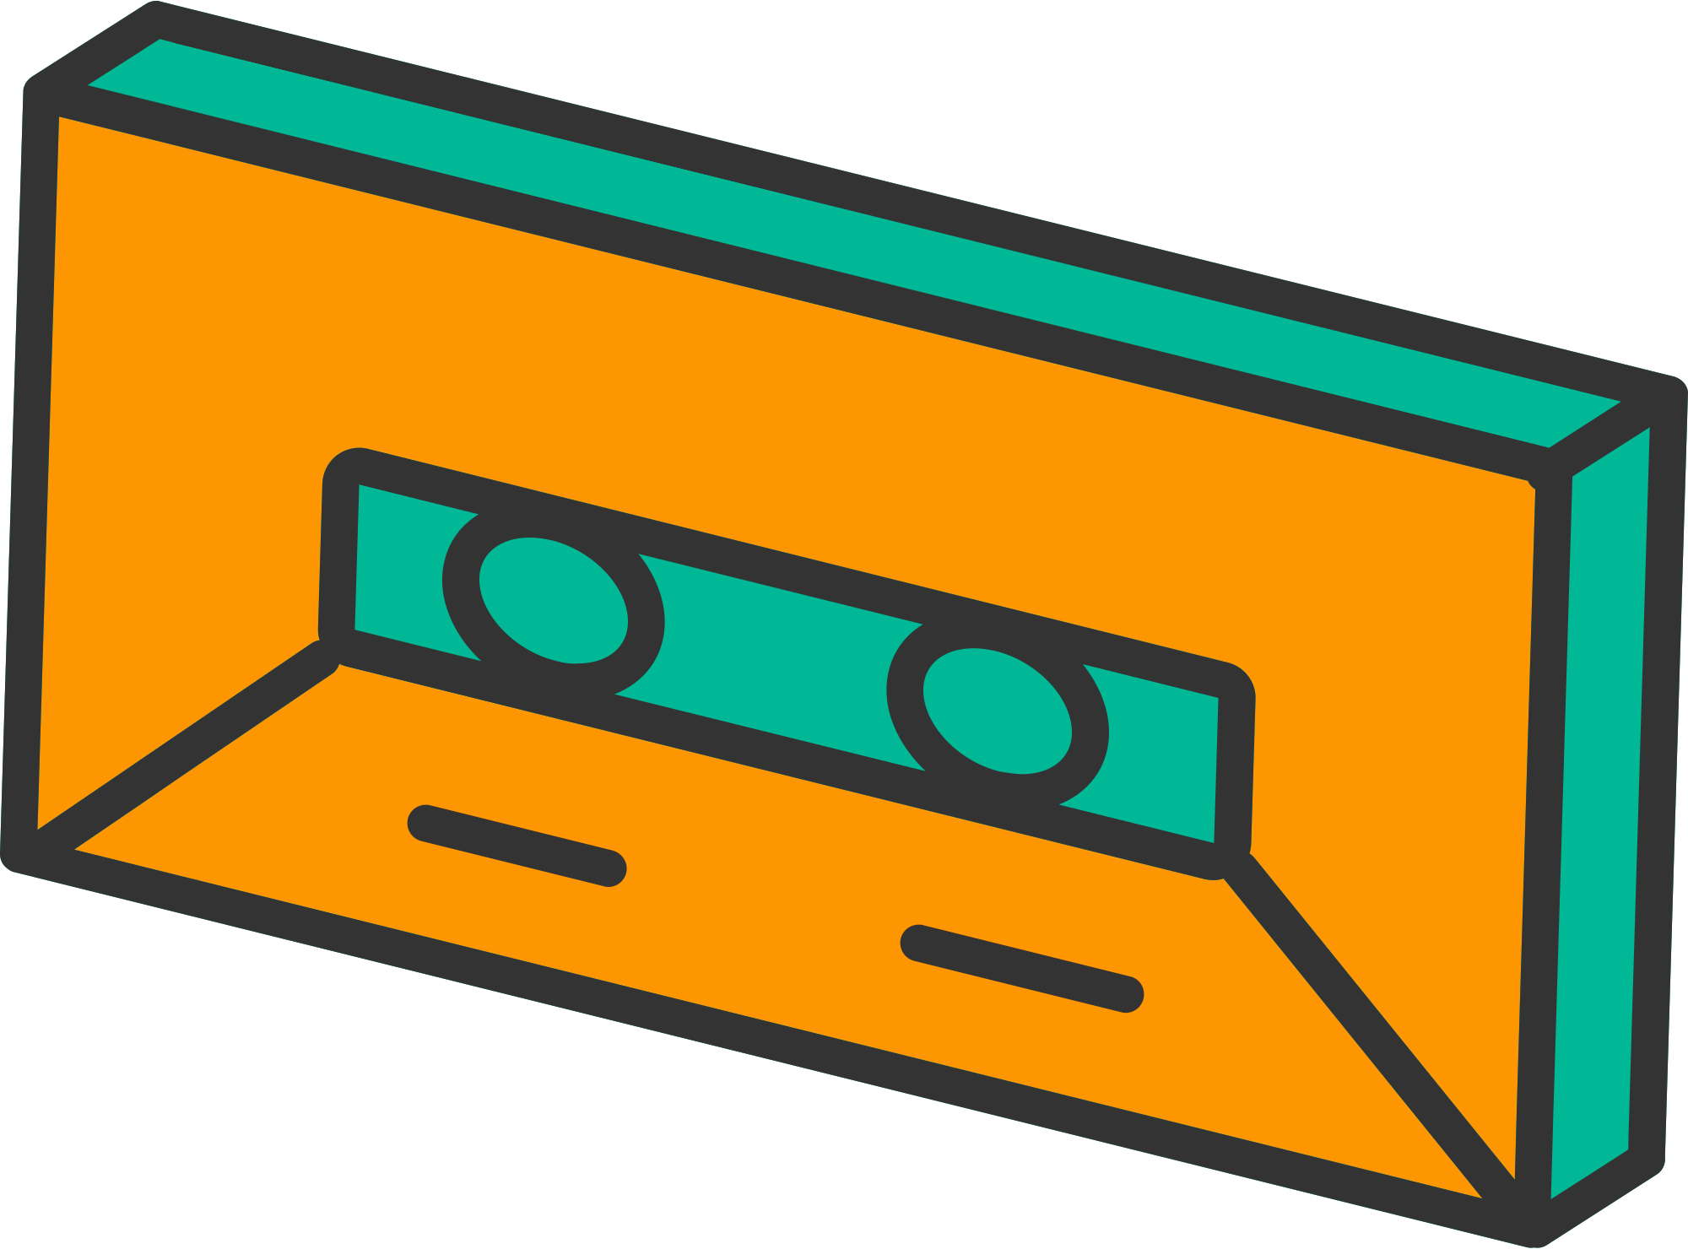

SPIN MASTER 3D
DES 666
ELECTRONICS FOR DESIGNERS
GROUP 10

Slide 2
An interactive and educational music-making tool for children using a combination of electronics and design.
The Spin-Master 3D is a turntable inspired toy that enables kids to create music by placing blocks of different heights on a spinning disc. Each block corresponds to one of the seven musical notes.
THE IDEA

Slide 3
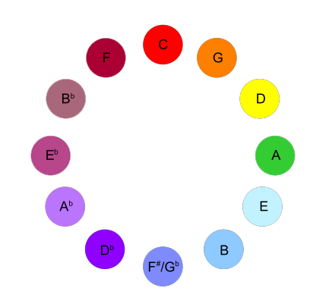
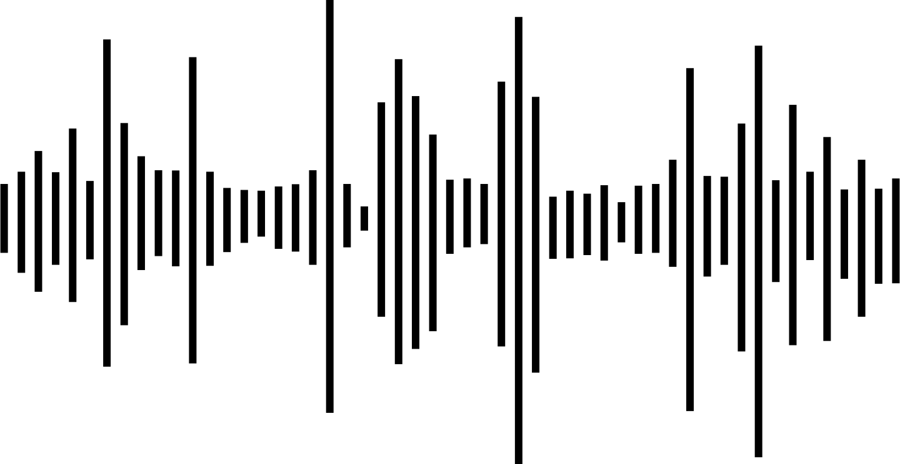
CONCEPTS
Scriabin's sound-to-color associations
Spinmaster 3D aims to guide the child to associate the pitch of a particular note to a visual cue. With pieces of varying heights correlating to musical notes, children arrange them to play tunes. This tactile experience builds neural connections, linking pitch to height, fostering musical understanding.
Alexander Scriabin, a Russian composer and pianist who is believed to have had chromesthesia - distinguished "spiritual" tonalities (like F-sharp major) from "earthly, material" ones (C major, F major). Furthermore, Alexander Scriabin developed a "keyboard with lights" or clavier à lumières, which directly matched musical notes with colors.

Slide 4


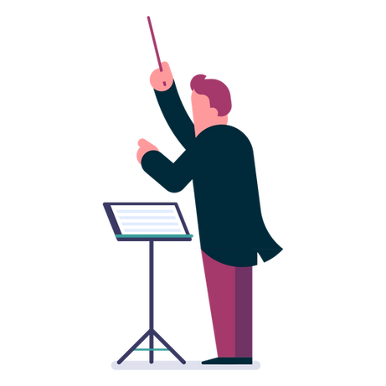
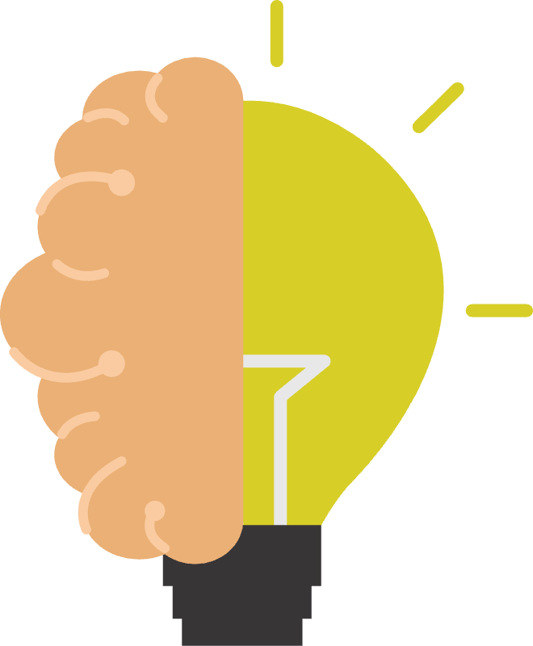
EDUCATIONAL VALUE
Introduction to Music Theory
Compostional Tool
Unlocking Creativity
By associating each note to a notebox of a particular height the device helps the user memorise the notes in music by tapping into a childs keen sense of visual memory
Unlike most musical toys for children, the spinmaster 3D not just allows users to play melodies but rather enables kids to use it as a music composition tool with a greater focus on the overall tune
Helps foster creativity by allowing children to create a symphony by building a visual composition of varying heights. Building a bridge between audi and visial arts.
Notes:
Introduction to Music Concepts: The interactive nature of the turntable introduces kids to fundamental music concepts such as notes, scales, and melodies. Through hands-on play, they can start understanding the relationship between different notes and how they come together to create music.
Sensorimotor Skills: Placing blocks of varying heights on the spinning disc requires fine motor skills and hand-eye coordination. This aspect of the project helps develop and refine the sensorimotor skills of children in the targeted age group.
Auditory Discrimination: The project encourages auditory discrimination as children listen to the different musical notes produced by the speaker. They learn to distinguish between high and low pitches, recognizing the variations in sound corresponding to the different block heights.
Cognitive Development: Engaging with the "Spin Master:3D" involves cognitive processes such as problem-solving and pattern recognition. Children learn to associate specific heights with particular musical notes, enhancing their cognitive development.
Creativity and Expression: The turntable provides a platform for creative expression. Kids can experiment with arranging blocks to create their own unique tunes, fostering creativity and a sense of accomplishment.
Educational Play: The project promotes learning through play, making the educational experience enjoyable and interactive. Kids can explore the world of music in a fun and non-intimidating way, cultivating a positive attitude towards learning.
Introduction to Technology: The incorporation of Arduino microcontroller and sensors introduces basic concepts of technology and electronics. While playing with the turntable, children are exposed to simple programming principles and the idea of cause-and-effect relationships.
Multisensory Learning: The combination of visual feedback (RGB lights), auditory feedback (musical notes), and tactile engagement (placing blocks) creates a multisensory learning experience. This approach enhances memory retention and overall understanding.

Slide 5
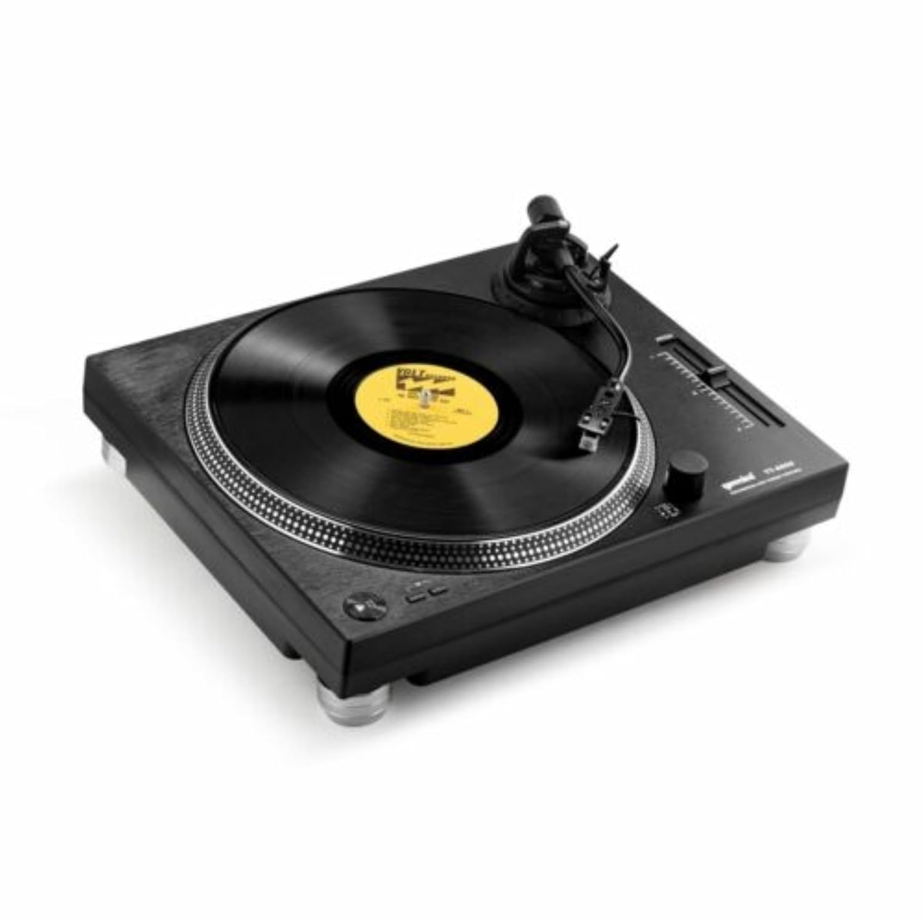
Design for the Spin Master 3D drew inspiration from modern turntables, combining sleek aesthetics with intuitive functionality
FORM INSPIRATION
The sleek and modern design of the Spin Master-3D, captures the imagination of children who are naturally drawn to innovative and futuristic gadgets.
The visually striking appearance, with its clean lines and accent colors, creates an immediate sense of excitement and curiosity. By mirroring the aesthetics of modern technology, the Spin Master 3D not only engages children on a sensory level but also cultivates a sense of empowerment and creativity, encouraging them to explore and experiment with music in a fun and captivating way.

Slide 6
COMPONENTS
BUILDING BLOCKS OF CREATIVITY
Arduino Microcontroller x1
Laser IR Sensor x1
Potentiometer x1
Buzzer x1
RGB Bulbs x8
Chassis - Sunboard & Acrylic

Slide 7
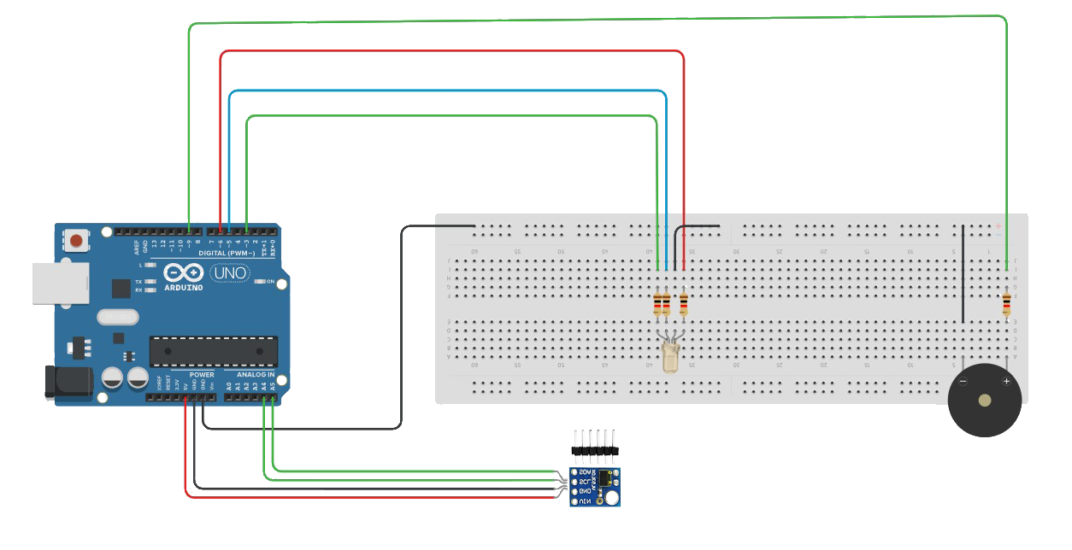
SIMPLIFIED SYSTEM ARCHITECURE
Arduino Microcontroller
RGB LED
Buzzer for Audio Output
Laser IR Sensor (LiDAR)

Slide 8
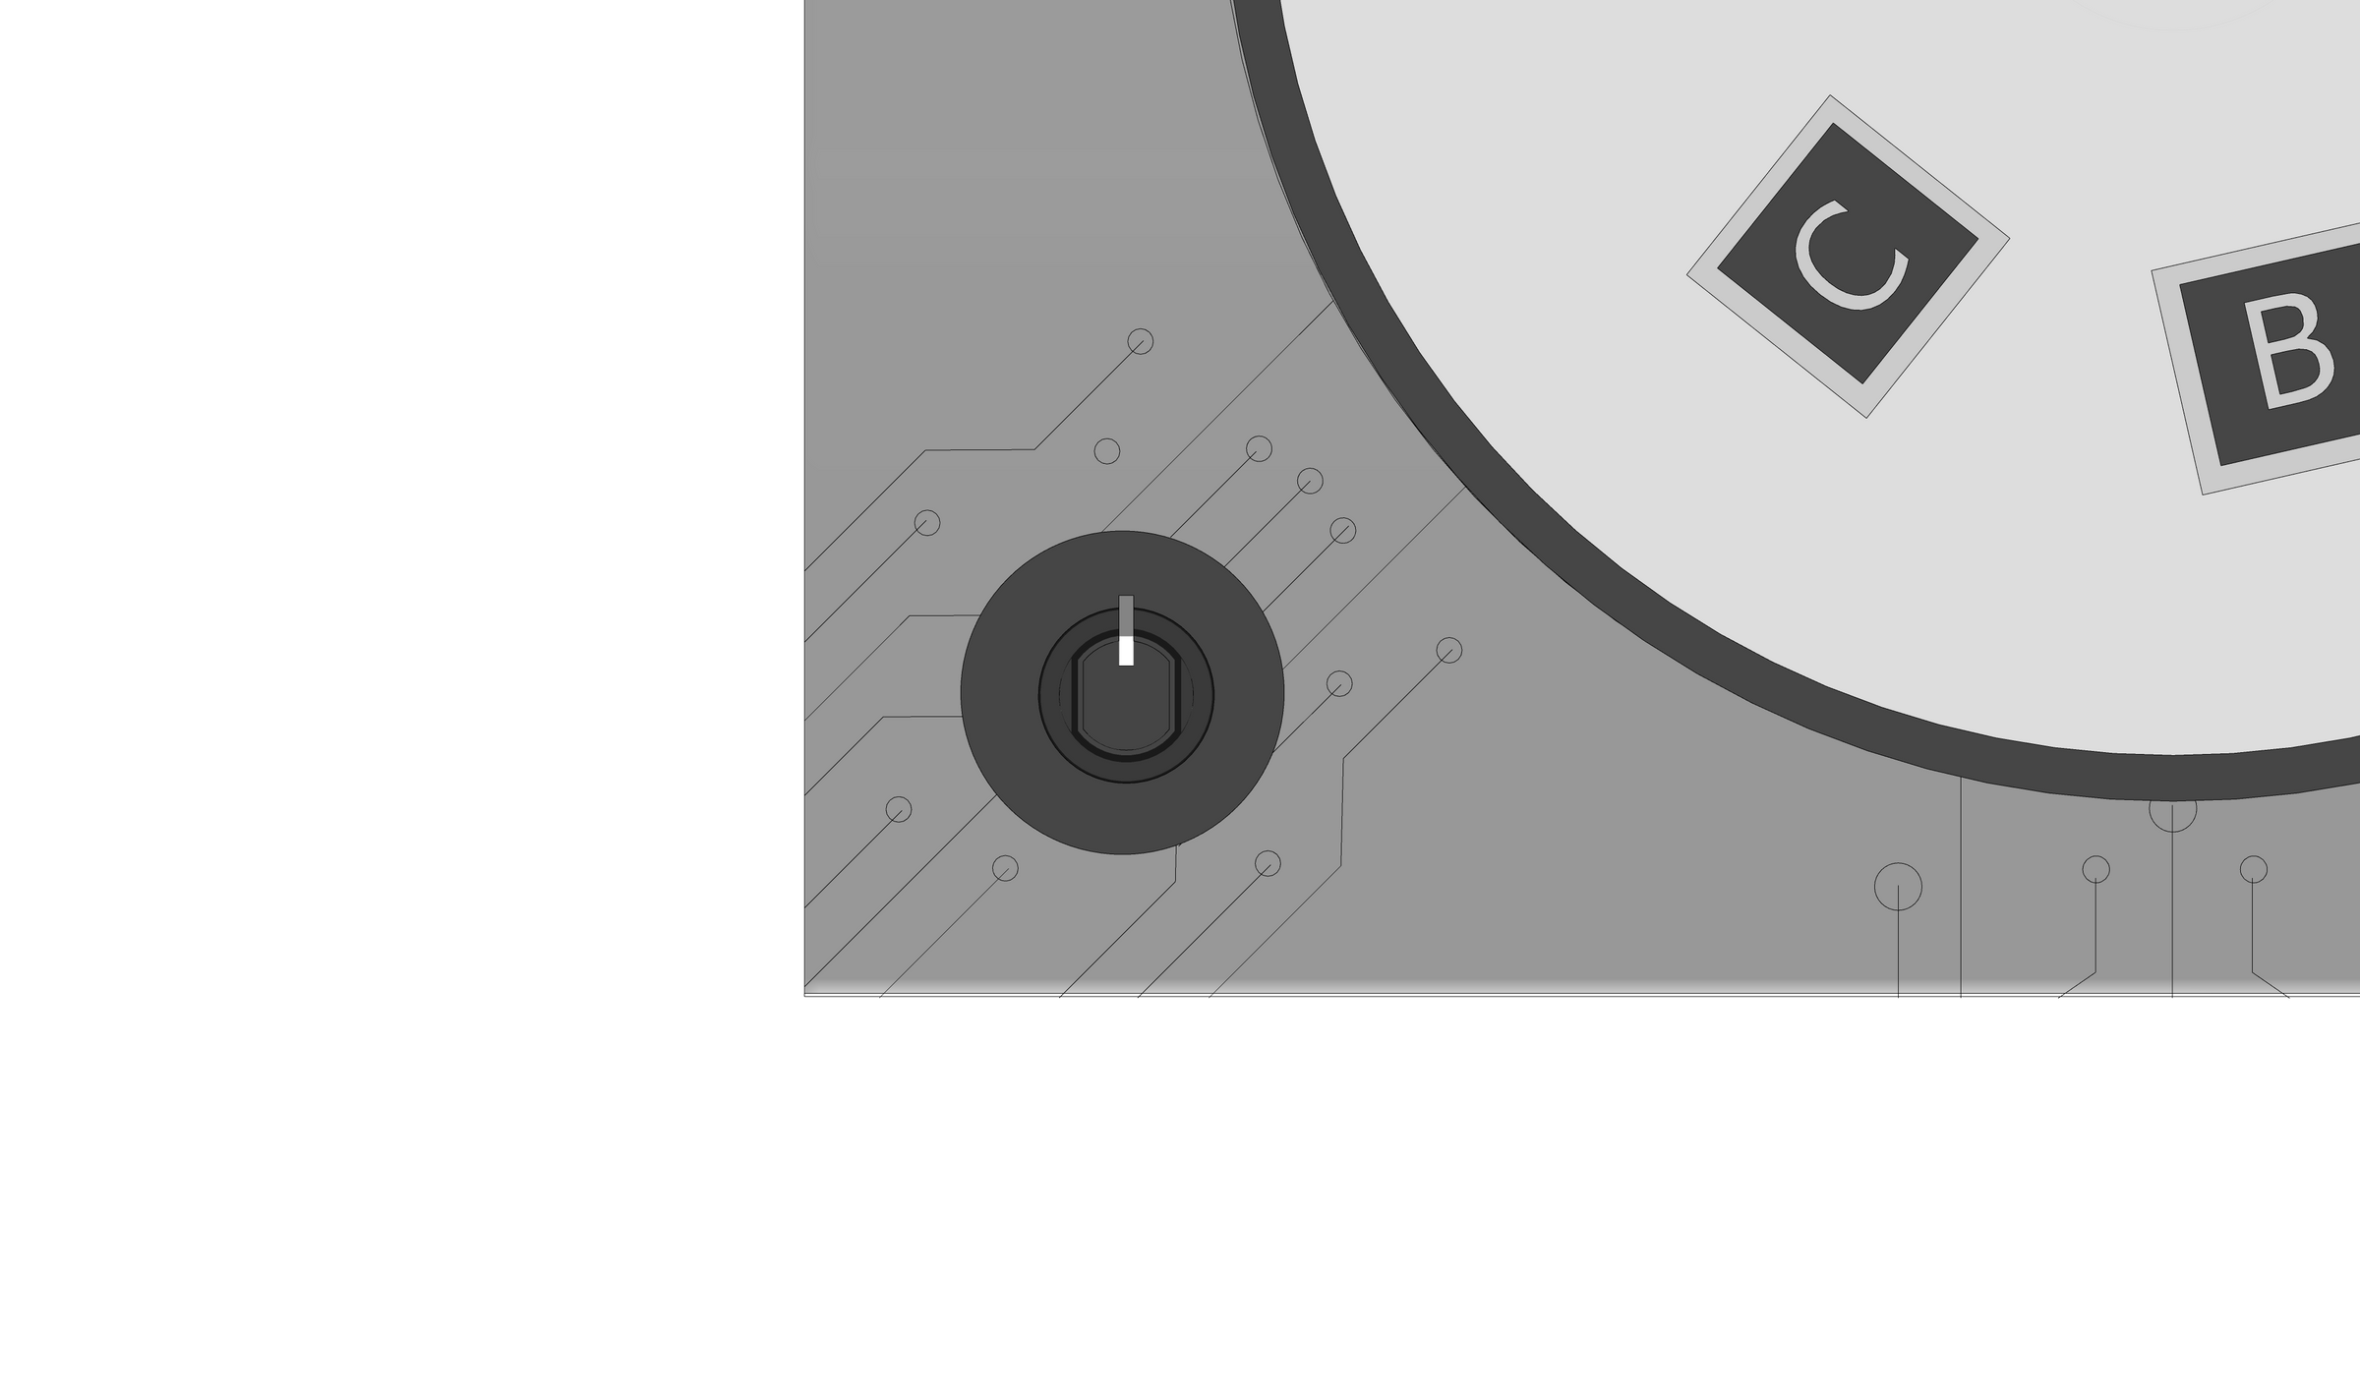


GAME MODES
The device features two distinct game modes each of which further enhance the child’s musical understanding.
Rotate the potentiometer knob to toggle between game modes
B
A
Tune Replication Mode
Children can Toggle between preloaded songs to hear popular childrens songs and attempt to rebuild it b matching notes
A
B
Freestyle Mode
Kids can use the freestyle mode to place noteboxes in their preferred order to create a myriad symphonies on the Spinmaster 3D

Slide 9
“TUNE REPLICATION MODE”: TUTORIAL
1
Insert Blocks: Place blocks of varying heights onto the spinning disc.
2
Rotate Disc: The disc spins, moving one block at a time.
3
IR Sensor Detects: An IR sensor at the bottom detects the height of each passing block.
4
Note Assignment: The microcontroller assigns a musical note based on block height.
5
Arduino Processes: Data goes to an Arduino microcontroller for processing.
6
Audio Output: A speaker plays the corresponding musical note.
7
RGB Lights Change: Lights change color based on the note, providing visual feedback.
8
Experiment and Learn: Kids can experiment, create melodies, and learn about notes and scales by playing with block placement.

Slide 10
START OF CIRCUIT
PM IS ROTATED
0° < PM ≤ 30°
30° < PM ≤ 110°
110° < PM ≤ 190°
190° < PM ≤ 270°
LOGIC
Toy OFF
Tune 1 Mode
Tune 2 Mode
Freestyle Mode
The logic behind the Spin Master 3D's operation is elegantly represented through a flow chart, illustrating the various conditions that can occur upon interacting with different parts of the toy.
Play Tune 1
Play Tune 2
HOLD
LiDAR Distance
≥
4 cm
HOLD
Note corresponding to height is played

Slide 11
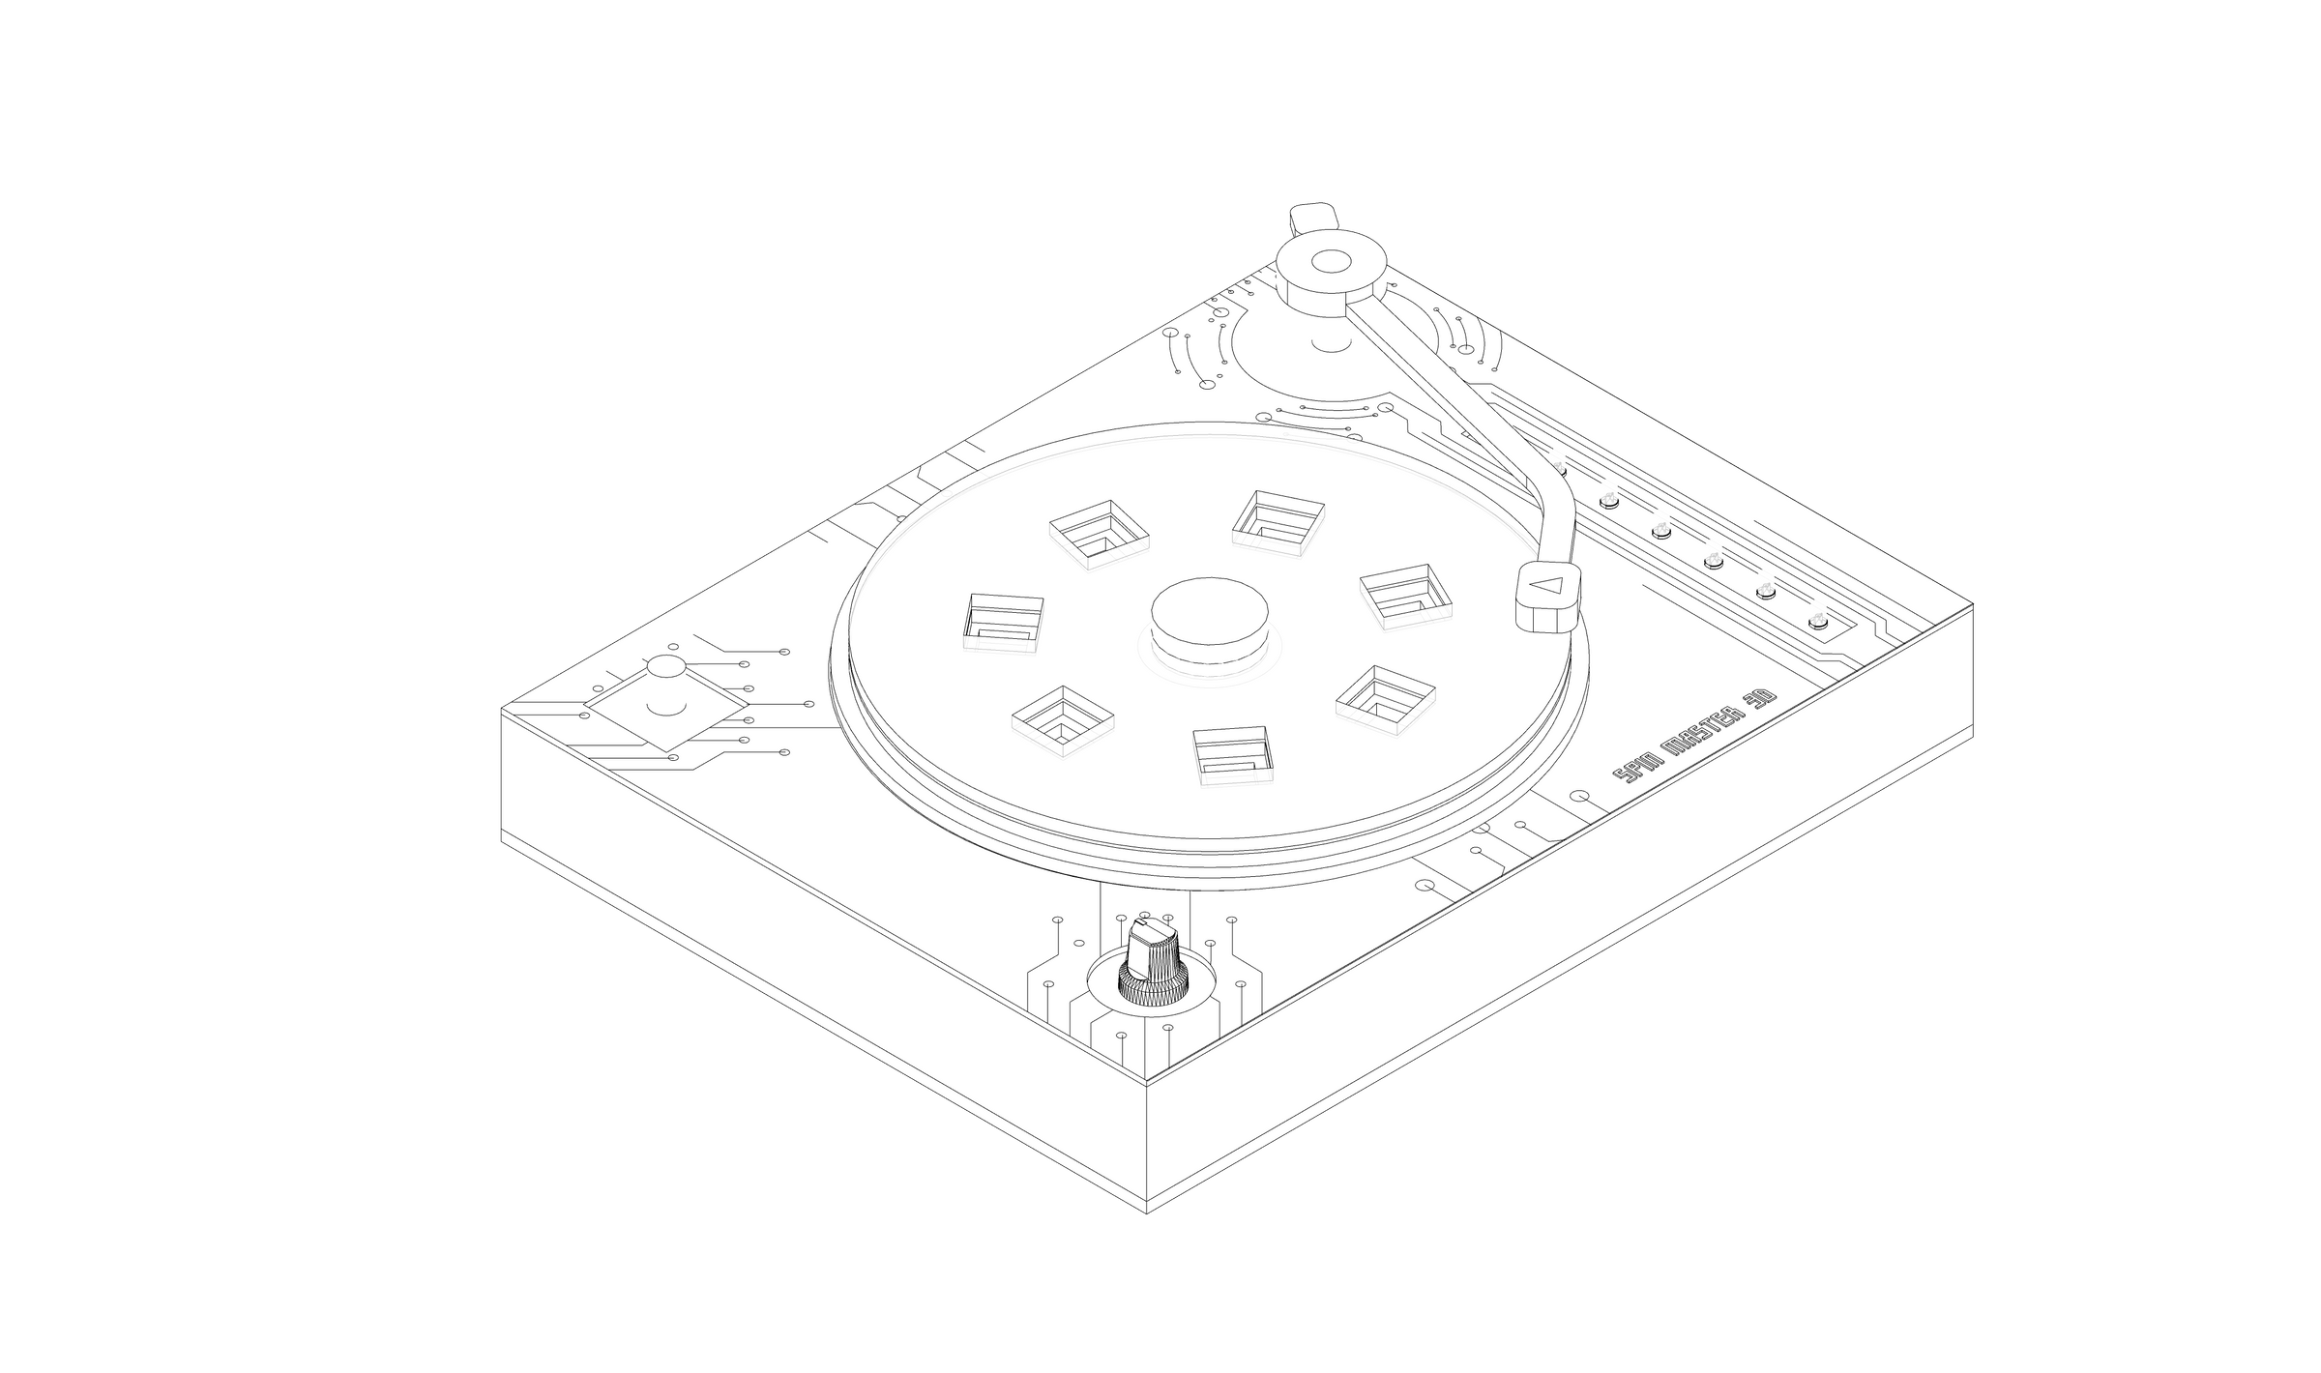
MOCKUPS

Slide 12
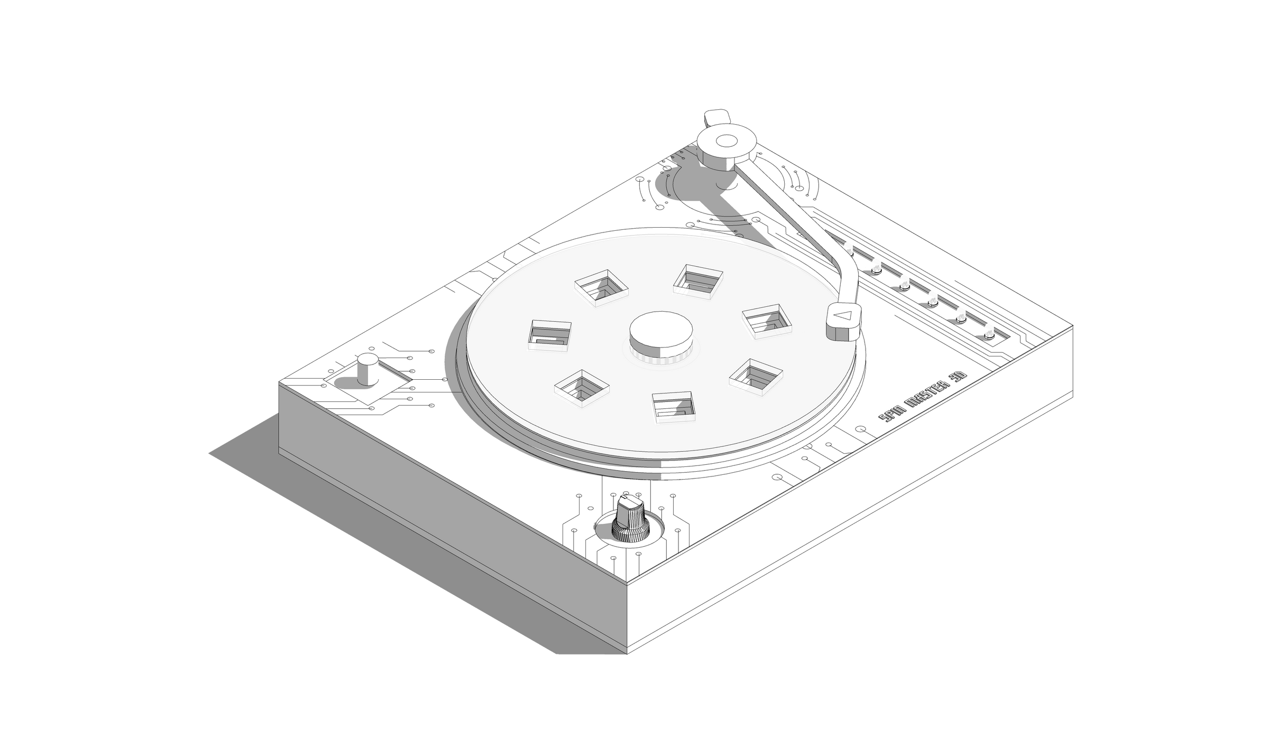
MOCKUPS

Slide 13
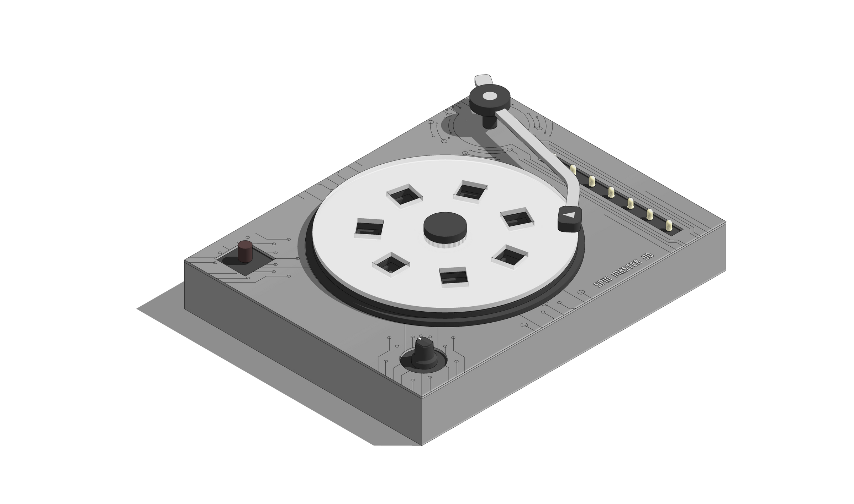
MOCKUPS

Slide 14
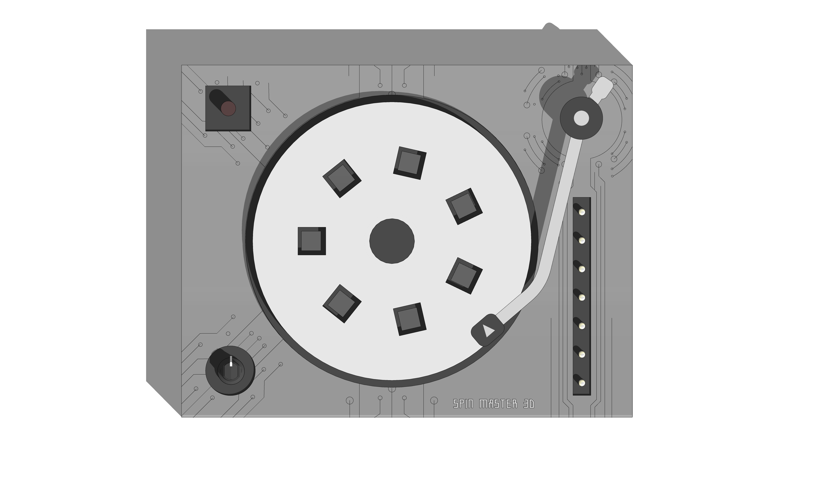

Slide 15
Buzzer

Slide 16
Buzzer
Potentiometer

Slide 17
Buzzer
RGB LED Bulbs
Potentiometer

Slide 18
Buzzer
RGB LED Bulbs
LiDAR Sensor Underneath
Potentiometer

Slide 19
Buzzer
RGB LED Bulbs
LiDAR Sensor Underneath
Potentiometer

Slide 20
CODE
#include <Wire.h>
#include <VL53L0X.h>
VL53L0X sensor;
int potpin = A2;
int piezopin = 10;
int redPin = 3;
int greenPin = 5;
int bluePin = 6;
bool twinPlayed = false;
bool maryPlayed = false;
int C = 261;
int D = 293;
int E = 329;
int F = 349;
int G = 392;
int A = 440;
int B = 493;
void playNote(int noteFrequency, int noteDuration)
{tone(piezopin, noteFrequency,noteDuration);
delay (50);
}
void setup()
{
pinMode(A0, OUTPUT);
pinMode(A2, INPUT);
pinMode(10, OUTPUT);
pinMode(3, OUTPUT);
pinMode(5, OUTPUT);
pinMode(6, OUTPUT);
twinPlayed = false;
maryPlayed = false;
Serial.begin(9600);
Wire.begin();
sensor.init();
sensor.setTimeout(500);
CODE
// Start continuous back-to-back mode (take readings as
// fast as possible). To use continuous timed mode
// instead, provide a desired inter-measurement period in
// ms (e.g. sensor.startContinuous(100)).
sensor.startContinuous();
}
void loop()
{
int distance =sensor.readRangeContinuousMillimeters();
//int distance =sensor.startContinuous(100);
//distance = distance;
Serial.print("Distance: ");
Serial.print(distance);
Serial.print("mm");
if (sensor.timeoutOccurred()) { Serial.print(" TIMEOUT"); }

Slide 21
Serial.println();
delay(100);
int potvalue= 800;
if((potvalue >= 0 && potvalue <124) || (potvalue>=419 && potvalue<424) || (potvalue>=719 && potvalue<724))
{ analogWrite(A0, 0);
digitalWrite(10,LOW);
maryPlayed = false;
twinPlayed = false;
}
if (potvalue >= 124 && potvalue <419) //Twinkle Twinkle Little Star
{ if(!twinPlayed){
playNote(C,500); analogWrite(redPin, 255); analogWrite(greenPin,0); analogWrite(bluePin,0);
delay(550);
playNote(C,500); analogWrite(redPin, 255); analogWrite(greenPin,0); analogWrite(bluePin,0);
delay(550);
playNote(G,500); analogWrite(redPin, 255); analogWrite(greenPin,165); analogWrite(bluePin,0);
delay(550);
playNote(G,500); analogWrite(redPin, 255); analogWrite(greenPin,165); analogWrite(bluePin,0);
delay(550);
playNote(A,500); analogWrite(redPin, 0); analogWrite(greenPin,255); analogWrite(bluePin,0);
delay(550);
playNote(A,500); analogWrite(redPin, 0); analogWrite(greenPin,255); analogWrite(bluePin,0);
delay(550);
playNote(G,500); analogWrite(redPin, 255); analogWrite(greenPin,165); analogWrite(bluePin,0);
delay(550);
noTone(10);
twinPlayed = true;
if (distance>50 && distance<=65)
{playNote(C,500);analogWrite(redPin, 255); analogWrite(greenPin,0); analogWrite(bluePin,0);}
if (distance>65 && distance<=80)
{playNote(D,500);analogWrite(redPin, 255); analogWrite(greenPin,255); analogWrite(bluePin,0);}
if (distance>80 && distance<=95)
{playNote(E,500);analogWrite(redPin, 135); analogWrite(greenPin,206); analogWrite(bluePin,235);}
if (distance>95 && distance<110)
{playNote(F,500);analogWrite(redPin, 124); analogWrite(greenPin,13); analogWrite(bluePin,14);}
if (distance>110 && distance<125)
{playNote(G,500);analogWrite(redPin, 255); analogWrite(greenPin,165); analogWrite(bluePin,0);}
if (distance>125 && distance<140)
{playNote(A,500);analogWrite(redPin, 0); analogWrite(greenPin,255); analogWrite(bluePin,0);}
if (distance>140 && distance<155)
{playNote(B,500);analogWrite(redPin, 0); analogWrite(greenPin,0); analogWrite(bluePin,255);}
}
CODE

Slide 22
if (potvalue >= 424 && potvalue <719) //Mary had a little lamb
{ if(!maryPlayed)
playNote(E,500);analogWrite(redPin, 135); analogWrite(greenPin,206); analogWrite(bluePin,235);
delay(550);
playNote(D,500);analogWrite(redPin, 255); analogWrite(greenPin,255); analogWrite(bluePin,0);
delay(550);
playNote(C,500);analogWrite(redPin, 255); analogWrite(greenPin,0); analogWrite(bluePin,0);
delay(550);
playNote(D,500);analogWrite(redPin, 255); analogWrite(greenPin,255); analogWrite(bluePin,0);
delay(550);
playNote(E,500);analogWrite(redPin, 135); analogWrite(greenPin,206); analogWrite(bluePin,235);
delay(550);
playNote(E,500);analogWrite(redPin, 135); analogWrite(greenPin,206); analogWrite(bluePin,235);
delay(550);
playNote(E,500);analogWrite(redPin, 135); analogWrite(greenPin,206); analogWrite(bluePin,235);
delay(550);
noTone(10); maryPlayed = true; }
if (distance>50 && distance<=65)
{playNote(C,500);analogWrite(redPin, 255); analogWrite(greenPin,0); analogWrite(bluePin,0);}
if (distance>65 && distance<=80)
{playNote(D,500);analogWrite(redPin, 255); analogWrite(greenPin,255); analogWrite(bluePin,0);}
if (distance>80 && distance<=95)
{playNote(E,500);analogWrite(redPin, 135); analogWrite(greenPin,206); analogWrite(bluePin,235);}
if (distance>95 && distance<110)
{playNote(F,500);analogWrite(redPin, 124); analogWrite(greenPin,13); analogWrite(bluePin,14);}
if (distance>110 && distance<125)
{playNote(G,500);analogWrite(redPin, 255); analogWrite(greenPin,165); analogWrite(bluePin,0);}
if (distance>125 && distance<140)
{playNote(A,500);analogWrite(redPin, 0); analogWrite(greenPin,255); analogWrite(bluePin,0);}
if (distance>140 && distance<155)
{playNote(B,500);analogWrite(redPin, 0); analogWrite(greenPin,0); analogWrite(bluePin,255);}
}
if (potvalue >= 724 && potvalue <1024)
{if (distance>50 && distance<=65)
{playNote(C,500);analogWrite(redPin, 255); analogWrite(greenPin,0); analogWrite(bluePin,0);}
if (distance>65 && distance<=80)
{playNote(D,500);analogWrite(redPin, 255); analogWrite(greenPin,255); analogWrite(bluePin,0);}
if (distance>80 && distance<=95)
{playNote(E,500);analogWrite(redPin, 135); analogWrite(greenPin,206); analogWrite(bluePin,235);}
if (distance>95 && distance<110)
{playNote(F,500);analogWrite(redPin, 124); analogWrite(greenPin,13); analogWrite(bluePin,14);}
if (distance>110 && distance<125)
{playNote(G,500);analogWrite(redPin, 255); analogWrite(greenPin,165); analogWrite(bluePin,0);}
if (distance>125 && distance<140)
{playNote(A,500);analogWrite(redPin, 0); analogWrite(greenPin,255); analogWrite(bluePin,0);}
if (distance>140 && distance<155)
{playNote(B,500);analogWrite(redPin, 0); analogWrite(greenPin,0); analogWrite(bluePin,255);}
}
CODE

Slide 23
if (distance>50 && distance<=65)
{playNote(C,500);analogWrite(redPin, 255); analogWrite(greenPin,0); analogWrite(bluePin,0);}
if (distance>65 && distance<=80)
{playNote(D,500);analogWrite(redPin, 255); analogWrite(greenPin,255); analogWrite(bluePin,0);}
if (distance>80 && distance<=95)
{playNote(E,500);analogWrite(redPin, 135); analogWrite(greenPin,206); analogWrite(bluePin,235);}
if (distance>95 && distance<110)
{playNote(F,500);analogWrite(redPin, 124); analogWrite(greenPin,13); analogWrite(bluePin,14);}
if (distance>110 && distance<125)
{playNote(G,500);analogWrite(redPin, 255); analogWrite(greenPin,165); analogWrite(bluePin,0);}
if (distance>125 && distance<140)
{playNote(A,500);analogWrite(redPin, 0); analogWrite(greenPin,255); analogWrite(bluePin,0);}
if (distance>140 && distance<155)
{playNote(B,500);analogWrite(redPin, 0); analogWrite(greenPin,0); analogWrite(bluePin,255);}
}
if (potvalue >= 724 && potvalue <1024)
{if (distance>50 && distance<=65)
{playNote(C,500);analogWrite(redPin, 255); analogWrite(greenPin,0); analogWrite(bluePin,0);}
if (distance>65 && distance<=80)
{playNote(D,500);analogWrite(redPin, 255); analogWrite(greenPin,255); analogWrite(bluePin,0);}
if (distance>80 && distance<=95)
{playNote(E,500);analogWrite(redPin, 135); analogWrite(greenPin,206); analogWrite(bluePin,235);}
if (distance>95 && distance<110)
{playNote(F,500);analogWrite(redPin, 124); analogWrite(greenPin,13); analogWrite(bluePin,14);}
if (distance>110 && distance<125)
{playNote(G,500);analogWrite(redPin, 255); analogWrite(greenPin,165); analogWrite(bluePin,0);}
if (distance>125 && distance<140)
{playNote(A,500);analogWrite(redPin, 0); analogWrite(greenPin,255); analogWrite(bluePin,0);}
if (distance>140 && distance<155)
{playNote(B,500);analogWrite(redPin, 0); analogWrite(greenPin,0); analogWrite(bluePin,255);}
}

Slide 24
TEAM
CONTRIBUTIONS
AMRITA WALIA
CONCEPTUALISATION, FORM DEVELOPMENT, PRESENTATION, VIDEO
ARUNAV RAJESH
CONCEPTUALISATION, FORM DEVELOPMENT, PRESENTATION, VIDEO
POOJA GUPTA
CONCEPTUALISATION, FORM DEVELOPMENT, PRESENTATION, VIDEO
RISHABH RAJ
CIRCUIT BUILDING, CODING
SACNHIT HARI
CIRCUIT BUILDING, CODING

Slide 25
THANK
YOU FOR YOUR TIME!
GROUP 10

